Slide 1

TITLE
British Airways
BA Predictive Modelling:
The Sky’s the Limit

Slide 2
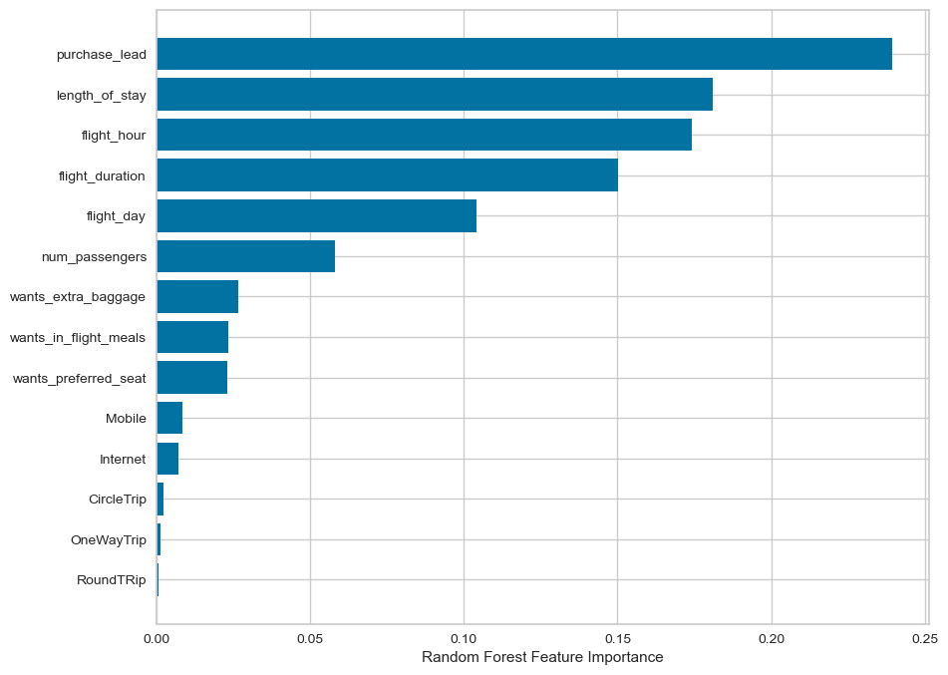
Predictive Modelling to Uncover Buying Behaviour Insights
We have trained the data set with a Random forest classifier model and received
Accuracy Score_trained: 0.86
Acc_score_Testing: 0.61
Purchase Lead
Length of stay
Flight hour
Flight duration
Flight day
are the top 5 variables which influence Customer buying behaviour
We need to increase the accuracy of the testing score

